Slide 1

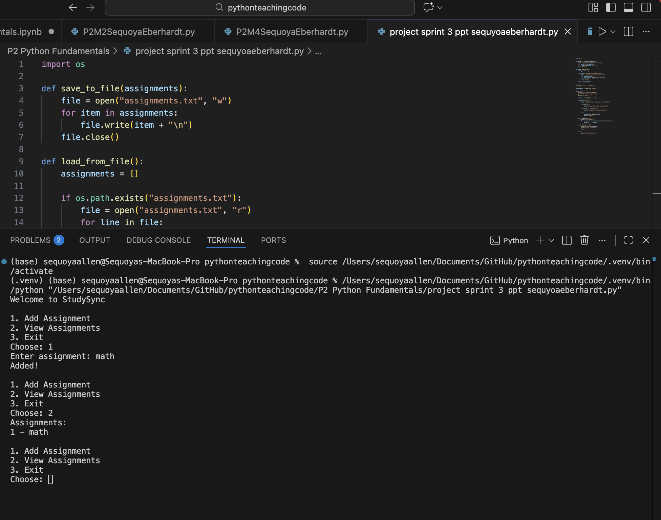
StudySync
A simple Python-based study & assignment tracker
Team: Sequoya Eberhardt (Solo Project)
Organize assignments, track deadlines, and stay on top of your work.

